Slide 1
CI/CD with MathWorks Tools
How MATLAB complements DevOps workflows
Filip Babiec, ONT

Slide 2
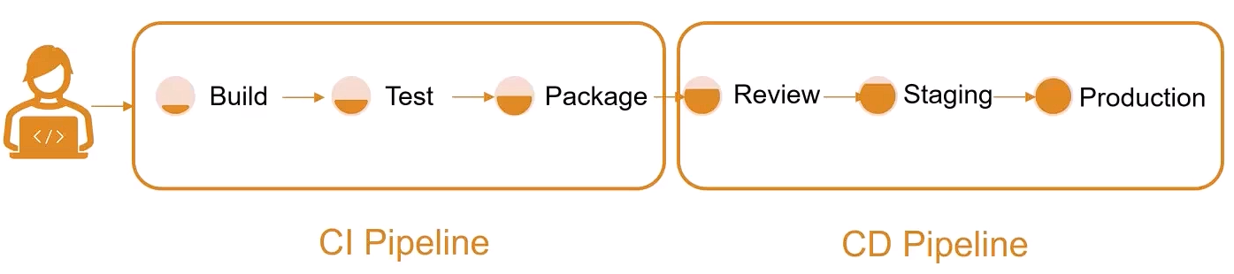
Continuous Integration & Continous Delivery / Deployment
Notes:
CI/CD is the combined practice of Continuous Integration (CI) and Continuous Delivery / Deployment (CD). It directly facilitates Agile development because software updates reach production more frequently.
This workflow focuses on the incorporation of automation tools that help to define the software life cycle. There is also a second, closely connected term - DevOps - that describes a combination of practices and tools specially designed to shorten the system's development life cycle.

Slide 3
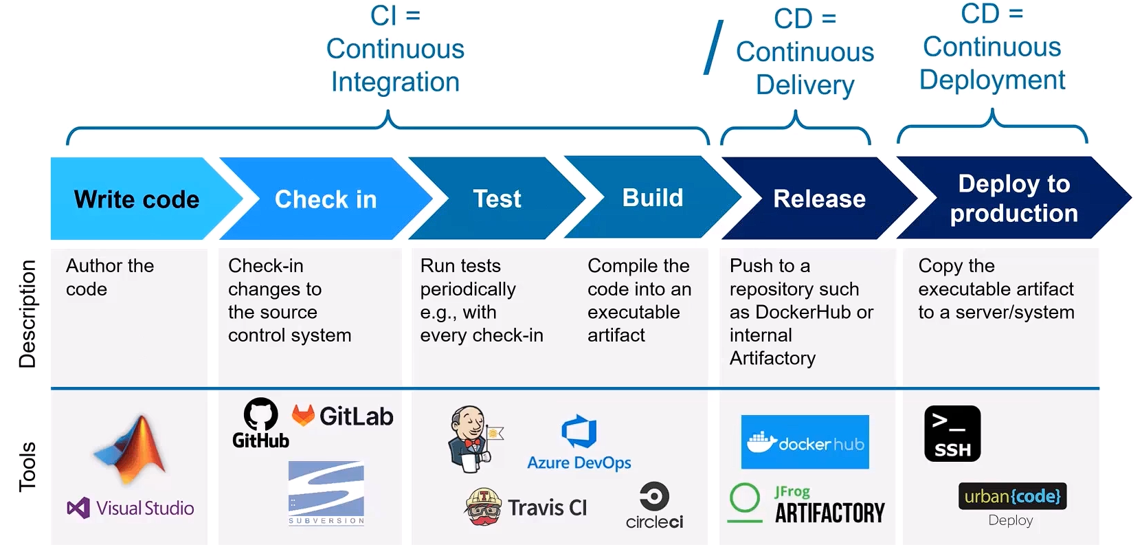
Continuous Integration & Continous Delivery / Deployment
Notes:
CI is the automation and integration of code changes from multiple developers into a single repository. These developers write and test code using automated test suites that validate the code before it is pushed into the shared repository.
CD on the other hand is the process of delivering the code updates to the production environment (Continuous Delivery). It releases the code in small batches to make it easy to fix bugs or revert back to previous versions. The Continuous Deployment releases the updated software that passes the 2 previous stages of the pipeline to the end users.

Slide 4
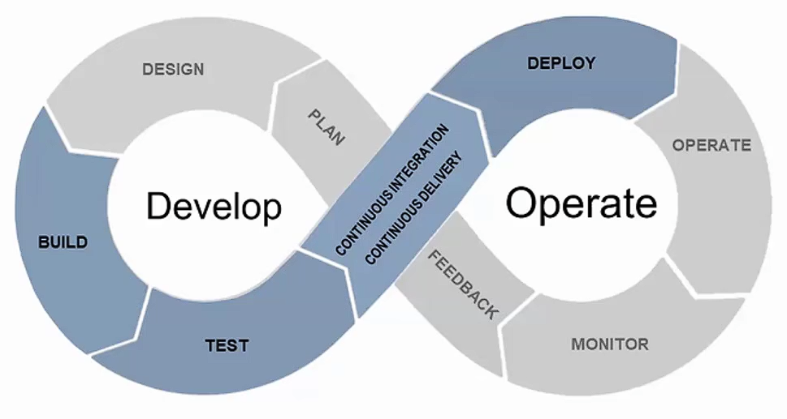
DevOps
Notes:
When it comes to DevOps it complements CI/CD by providing a framework that promotes collaboration, communication and shared responsibility among the team. It is the integration of the software development and operations that encompasses necessary tasks that lead to shortening the development time and improving the development life cycle.

Slide 5
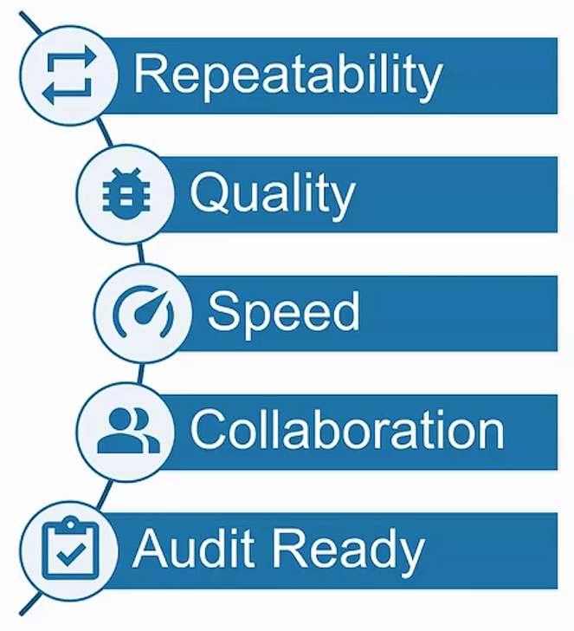
Advantages & Benefits
Consistent, repeatable environment
Automate testing of latest changes
Test early, test often
Identify integration issues quickly
Trace issues to the source
Notes:
Benefits of using CI/CD and DevOps

Slide 6
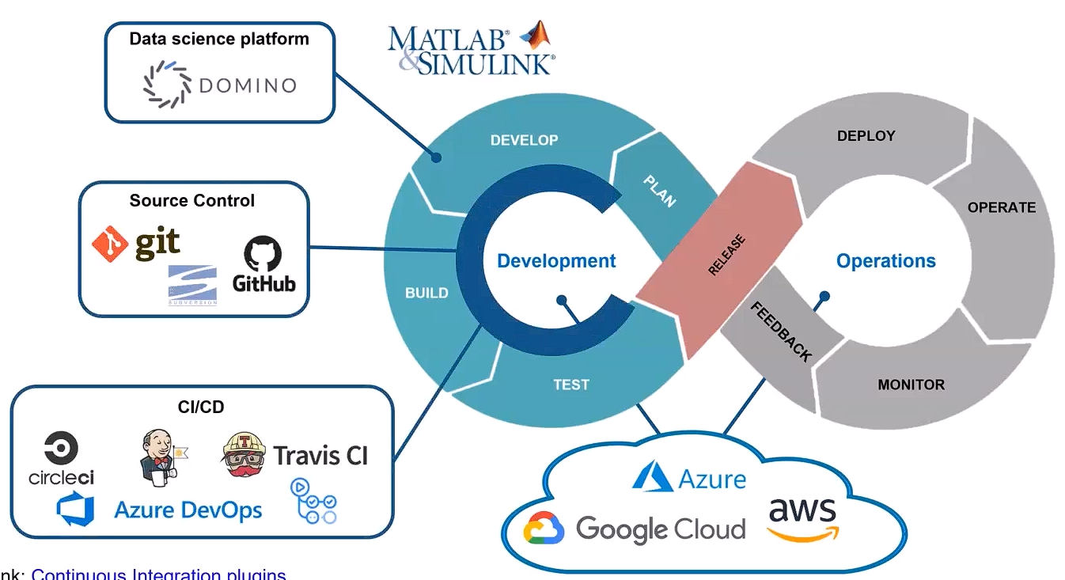
MATLAB & Simulink Integration with DevOps Tools
Notes:
After discussing these two main concepts, it is best to talk about how MATLAB tools complement and fit in the CI/CD and DevOps workflows.

Slide 7
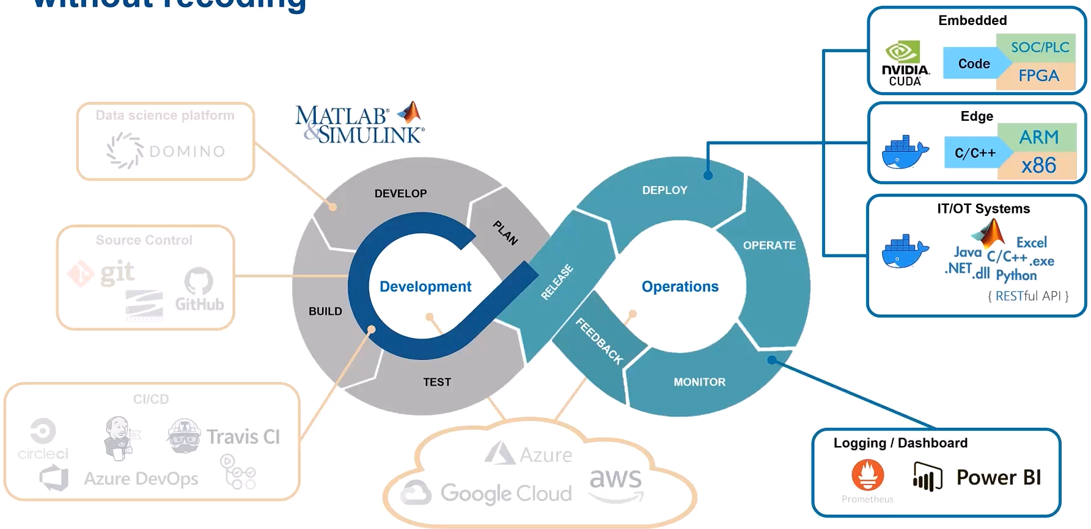
MATLAB & Simulink Integration with DevOps Tools

Slide 8
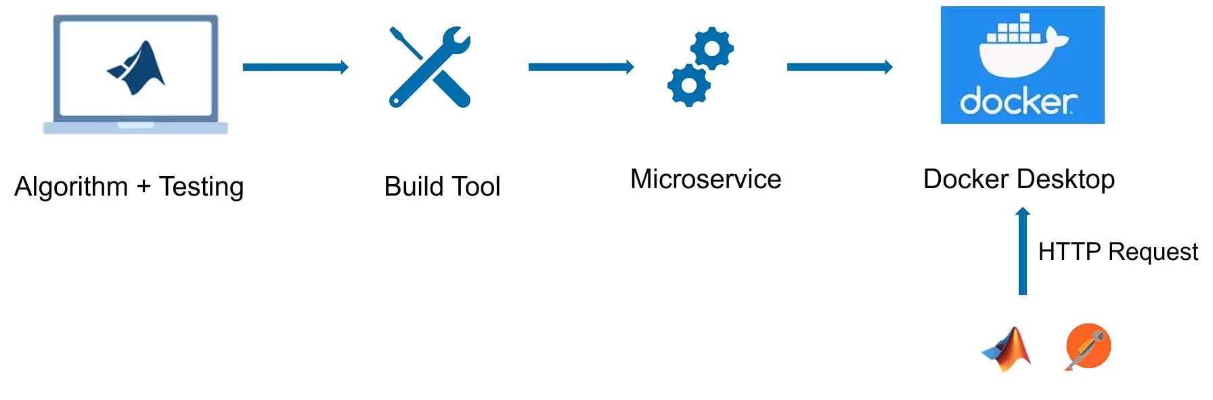
Demo 1: Deploy a Microservice Docker Image on Local Machine
Notes:
Demo 1: Write algorithm in MATLAB -> add tests (with copilot) -> build tool to create a build plan -> package the results as microservice -> put them in a container -> send a RESTful API through MATLAB

Slide 9
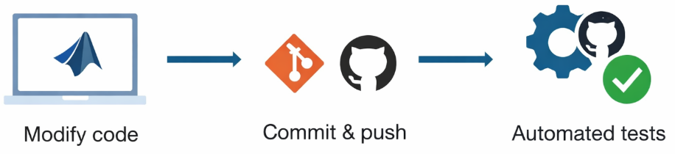
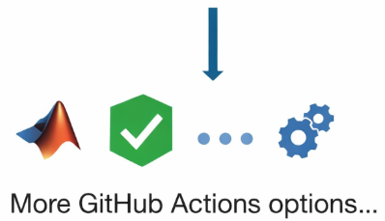
Demo 2: Trigger MATLAB tests automatically via GitHub Actions
Notes:
Demo 2:
Make a change in the code Hvac controller -> Commit and push the code to the repository -> Repository automatically triggers tests -> Show how this is done in GitHub

Slide 10
Demo 3: Process Advisor
Open simulink model
Initialize git repository, or show already initialized
Open proces advisor (from within matlab project tab)
Show information about one of the processes by pressing „i” icon next to it
Go to edit (this opens the script)
Turn on the design error detection task by changing its value to true
Show how to edit specific tasks
Run a signle task (maintainability report and open the output)
Modify a small thing in the model and show that some tasks are now outdated (grey)
Run proces advisor (show different rerun options)
Generate report from the process
Notes:
Demo 3:
Automate and Run Tasks with Process Advisor - MATLAB & Simulink

Slide 11
Demo 4: Jenkins Pipeline
Notes:
Demo 4:

